Slide 1
WEEK 1-2: ORIENTATION
PROJECT MANAGEMENT
MS. DITTAS A. FORMOSO

Slide 2
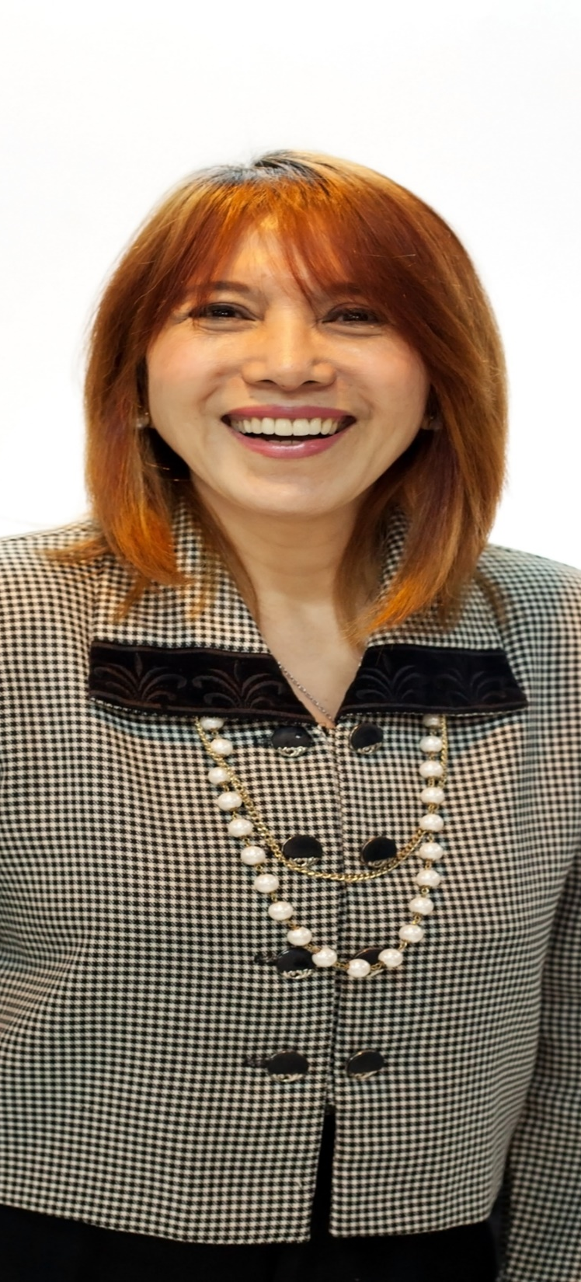
Ms. Dittas Formoso
YOUR MENTOR
Over 30 years in Information Technology
Has served as consultant for local and foreign based companies including The World Bank
Certified Change Management Professional
Certified Project Management Instructor - Accenture
Holds a Masters Degree in Information Systems
Currently a Doctoral Candidate for Organization Development
Plays classical music on the piano
A wanderlust, 54 countries
Influencers: My Dad and Oprah Winfrey
Notes:
20 years in information technology, mostly in selling and managing enterprise projects either direct or thru partners
Has served as consultant for both local and foreign based companies, including The World Bank
Holds a Masters Degree in Information Systems
Currently a Doctoral Candidate in Organization Development
Plays classical music on the piano
A wanderlust; 50 countries and counting
A health and dance enthusiast

Slide 3
LEARNING OUTCOME
Know OLFU Vision and Mission
Know OLFU values
Understand the requirements for the course

Slide 4
INDIVIDUAL INTRODUCTION
Name
Nickname
Where do you live?
How many siblings? What’s your position?
What are you passionate about?
What are your pet peeves (things you don’t like)
If you were a superhero, a cartoon or a game character who would you be and why?
Your talent or hobby
Why did you choose EMC?

Slide 5
SET UP A VIBER GROUP FOR IMPORTANT ANNOUNCEMENTS: PROJ MGMT
Dittas Formoso 0920 908 8948

Slide 6
OUTCOME OF THE COURSE
The students will be able to apply the skills and concepts in managing a project through group activities.
The students will experience the cycle of project management, from initiation to closure.
The Students will learn the skills necessary to become effective project managers.

Slide 7
Detailed Outcome
1) Understand project management design, development, and deployment
2) Use project management tools, techniques, and skills
3) Align critical resources for effective project implementation
4) Understand the implications, challenges, and opportunities of organizational dynamics in project management
5) Identify and use key performance metrics for project success
6) Understand how to manage project cost, quality, and delivery
7) Engage and lead effective project management teams in your organization
8) Recognize and mitigate the early seeds of failure in the project life cycle

Slide 8
GRADE COMPONENTS
Class Participation
Recitations
Quizzes
Project
Prelims (theoretical)
Midterms (theoretical and group project)
Finals (theoretical and group project)

Slide 9
COURSE CONTENT
Week 1-2: Course Module Orientation
Week 3-4: Introduction to Project Management
Week 5-6 : Project Initiation
Week 6: Prelims
Week 7-8: Project Planning
Week 9-10: Project Execution
Week 11-12: Project Control

Slide 10
COURSE CONTENT
Week 12: Midterm Exams and Project
Week 13-14: Project Closure
Week 15-16: : Project Quality Management
Week 17-18: Essential Skills of a Project Manager
Week 18: Final Exams and Project

Slide 11

INTRODUCTIONTO
OLFU VISION,MISSION,
VALUES

Slide 12



OLFUVISION (MUST MEMORIZETHIS)
A premier inclusive university of choice aspiring
to improve man as man by developing individuals
through a
legacy of excellent education
and compassionate value formation.

Slide 13

OLFU MISSION (7):REMEMBERTHE
KEY PHRASES ONLY
1) Commit itself to the service of society through quality education.
2) Develop the capabilities of individuals in order to maximize their potentials.
3) Nurture future professionals with the requisite academic foundation and conventional skills so as
to mold them into highly respected leaders and members of society.
4) Respond effectively to the changing needs and conditions of the times through continuing
education and research.
5) Inculcate social awareness through community outreach program.
6) Imbue a deep sense of nationalism and pride in our Filipino language.
7) Uphold virtues of truth,justice,integrity,compassion and faith in GOD

Slide 14
OLFU CORE VALUES (must memorize these)
A-aspires to do his best
C-is credible and compassionate
H-is hardworking and honorable
I-is an inspiration to others
E- efficient, effective and ethical
V-is a visionary
E-is entrepreneurial, employable, and excellent work habits
R-is responsible

Slide 15
GROUP ACTIVITY
Let’s create groups
Create an ePoster per group. A4 size.
Poster must include pair name, logo, slogan, names of members. Leave space for the name of your project
Dramatize one of OLFU’s core values. You can do this live or you can create a video. Should last at least 5 minutes.

Slide 16

https://www.youtube.com/watch?v=-GwBNwZOPUs

Slide 17
FROM THE VIDEO, PRESENT THE FOLLOWING
What are the stages/components of a project life cycle
What documents are produced in each stage/ component?

